Slide 1
Distribution of Department Capacity
Software application

Slide 2
Distribution of Department Capacity
Work hours of teachers
Define salary (based on capacity)
Department statistic

Slide 3
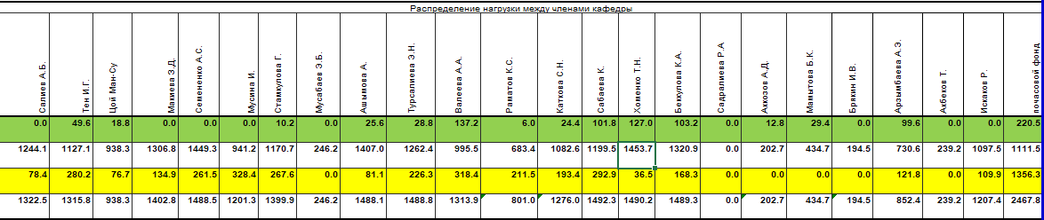
Distributed time

Slide 4
Costumers
There are 62 universities in Kyrgyzstan.
Every university has at least 15 different departments.
It means more than 930 unique potential costumer

Slide 5
Promotion
To make an agreement to the main hub of universities – Ministry of Education

Slide 6
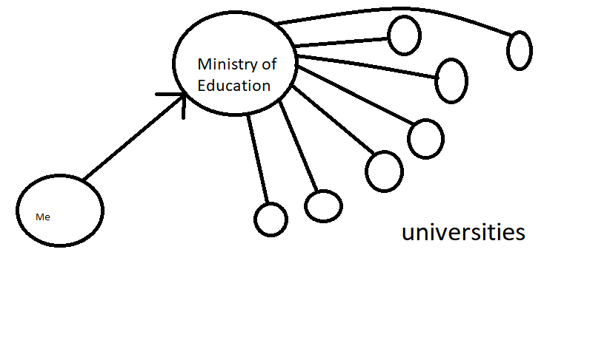

Slide 7
Description
Every university must contact with Ministry to get academic plan. It means that Ministry of Education can make offer to universities to buy this software.

